Slide 1


WELCOME
SU Elections Training
Max McLoughlin – Union CEO
Richard Broome – Membership Services Manager
Nadine Al-Kudcy – Student Voice & Activities Manager
Ed Robinson – Student Voice Coordinator
Rachel Smith – Societies Coordinator

Slide 2

Icebreaker…

Slide 3
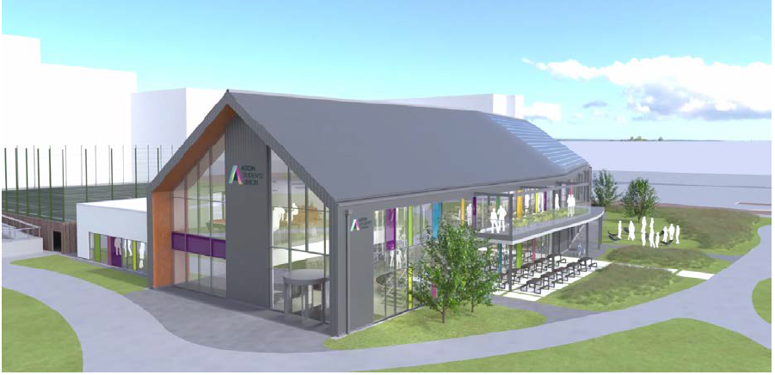
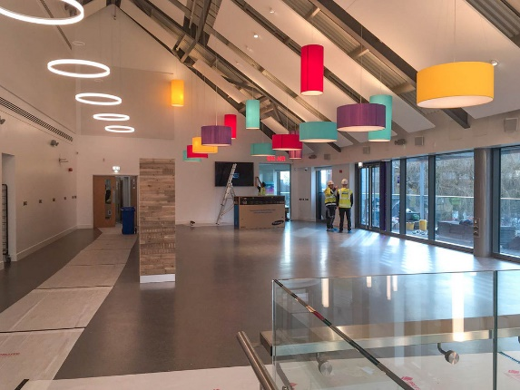
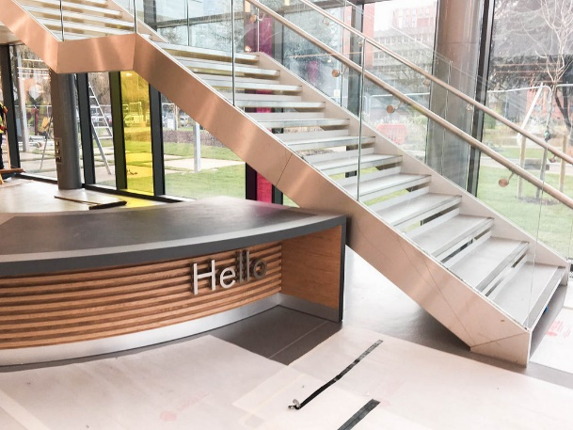
Your SU
Our brand new building – hopefully you now know it quite well!
The most modern and sustainable building on campus
The winners of this election will become the second Officer team to start their term in the building!

Slide 4
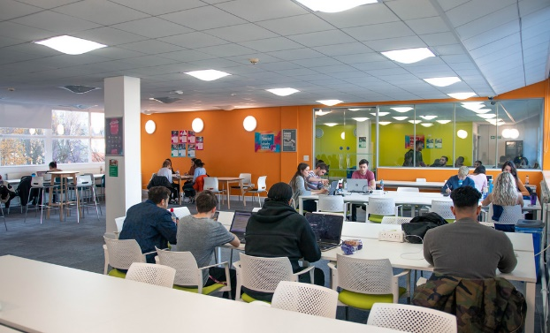
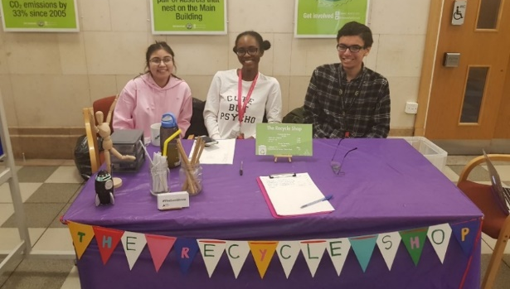
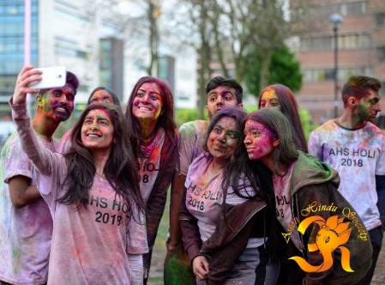
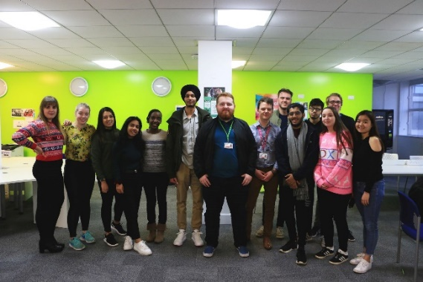
Your SU
Is a democratic, student-led organisation
A charity, but with commercial outlets (shop, bar, café)
Run by a team of 14 Officers – four full-time Officers, and ten part-time officers
Supported by a team of permanent staff, as well as student & placement staff

Slide 5

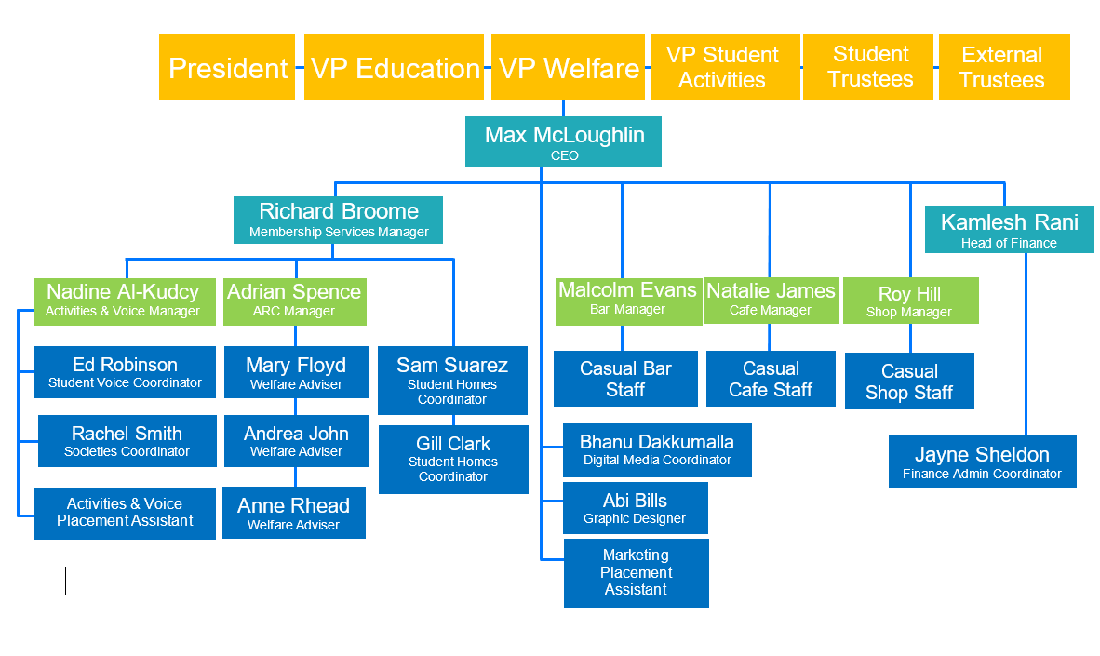
Organisational Chart
Trustee Board & Officers
Senior Management Team
Operational Management Team
Staff Team

Slide 6
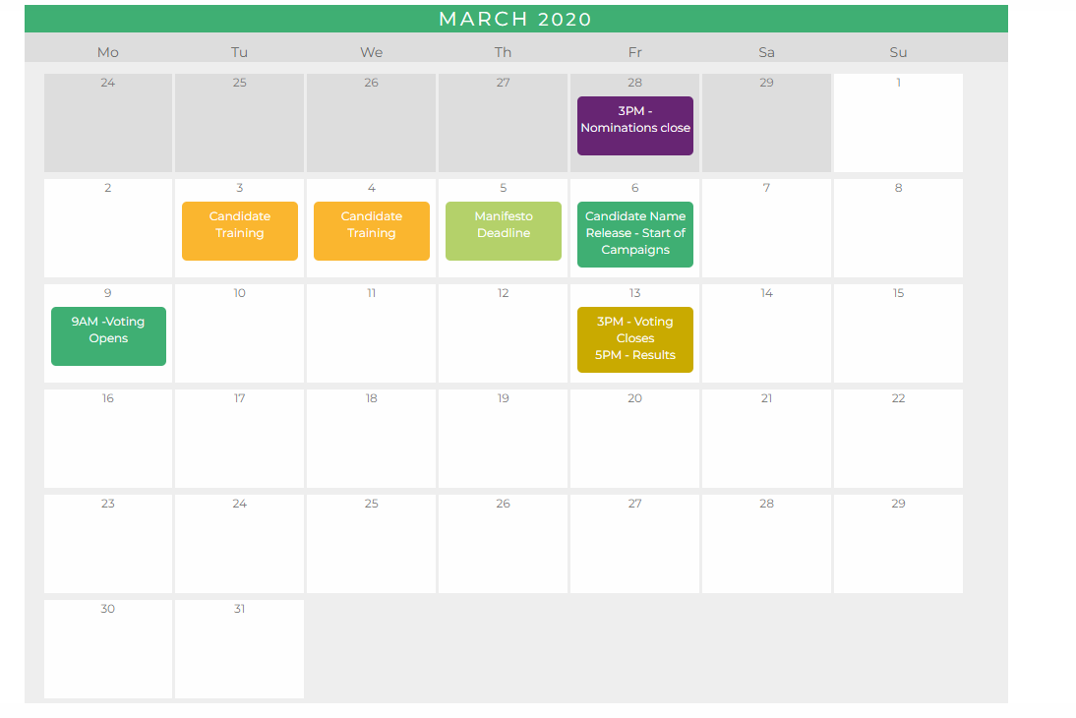
Key Dates
Manifesto Deadline: Thursday 5 March, 2PM
Candidate Name Release: Friday 6 March – 3PM
You may start your (online) campaign at this point.
Voting opens Monday 9 March 9AM and closes Friday 13 March, 3PM.

Slide 7
Demographic info

Slide 8
Demographic info

Slide 9
Demographic info

Slide 10
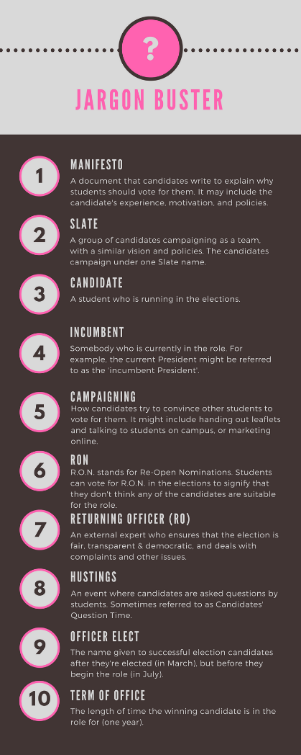

Slide 11
Rules & Regs
ELECTION RULES 2020
1. No coercion.
This means you cannot pressurise or force students to vote for you. Standing over a student and watching them vote may be seen as coercion. Candidates should not give electronic devices to voters to make them vote.
2. No bribery (financial or otherwise).
This means that you cannot pay students to vote for you or offer to do something for them in order to get them to vote for you.
3. No illegal discrimination.
Candidates should not do anything that could be discriminatory against protected characteristics (Gender, Race, Religion, Disability, Sexual Orientation).
4. All campaign materials should be approved in principle by the Deputy Returning Officer.
This does not mean every email and every Tweet, but posters and leaflets should be approved.

Slide 12
Rules & Regs
5. All current Aston University and Aston SU rules must be complied with.
Local rules apply. For example the Library will not allow any campaigning inside the Library. A breach of this local rule is a breach of the Election Rules.
Different schools will have different rules. Some may allow you to leave leaflets in their office. Others may not. If they allow 1 candidate to leave leaflets they must allow all candidates to do so. The university is not allowed to show preference to 1 candidate over another.
BREACHES OF ELECTION RULES
Any breaches of rules should be reported to the Deputy Returning Officer on union.returningofficer@aston.ac.uk .
What happens if the rules are broken?
Some examples:
The candidate could be asked to issue an apology and this could be placed on the SU website/social media.
A candidate could be disqualified from the election/
A candidate could be reported to the university and/or other authorities.

Slide 13
Rules & Regs
ELECTION RULES – GUIDING PRINCIPLES
All Candidates should have equal and fair access to be able to communicate with students.
Current officers or students in a position within the union should not use that position to advantage themselves. This includes SU Course Reps using email lists to contact voters.
Candidates should not canvas or seek the support of Aston university or union staff.
There will be equal support offered to all candidates.
Candidates must be open and honest in their campaigning
All students should be given a free and fair choice at the point of voting.
Voters should not be harassed or given direct instruction on how to vote at the point they are making their vote
Campaigning should be done by students at Aston to students at Aston.
Negative campaigning should be avoided. This is focussing on bad things or perceived bad things about other candidates. Campaigning should be based on what you will bring to the role.
Candidates should not ask for the support of SU staff.
Ignorance will not normally be considered a defence
Teams/slates are permitted.

Slide 14
Rules & Regs
https://www.youtube.com/watch?v=RKir-RvMcQM

Slide 15
The Budget
Candidates will have a budget that they can use to purchase materials for their election campaign.
All candidates have a budget of £60.
Do not go over budget. Keep track of what you are spending. If you spend nothing, you should let us know that this is the case.
EVERYTHING you buy & use must be included in your budget. You are not allowed to ‘top up’ your budget with your own money.
How does it work?
Candidates will spend their budget and reclaim their spending by completing a Personal Claim form.
Speak to us in the office to get one of these. These must be accompanied by full, itemised receipts of your campaign spending.
ALL CLAIMS will need to be handed into Student Voice by 1pm on Friday 13th March.
Candidate spending will be available for other candidates to scrutinise at 1-5pm on
Friday 13th March.

Slide 16

How does voting work?

Slide 17
Creating a Manifesto
What is a manifesto?
A manifesto is a short text that candidates can use to try and convince voters to vote for them. To this end, it usually contains information about:
Who you are and what position you are running for
Why you want to win the election – why are you passionate about this role?
What you would do if you won the election – what projects and policies would you introduce?
What experience and skills you have that make you a good candidate – have you been involved in the SU before? Have you worked on projects related to the role?
Often it will include a slogan – to make your campaign more memorable!

Slide 18

Creating a Manifesto
It’s a chance for you to ‘talk’ to students you might not meet while campaigning.
How can you get them on your side?
What do students care about?
Ask your friends!
What would make people vote for you?

Slide 19
Creating a Manifesto
Who am I?
My name’s Stu Dent and I’m running to be your President!
Why am I running?
I live and breathe the Students’ Union, and I want to use my passion to make sure that the Students’ Union can thrive in the future.
What will I do?
If you elect me as your President, I will:
Push to ensure that students get a fair accommodation deal on campus
Make scrutiny of your Officers more transparent
Why vote for me?
I’ve got bags of experience of working with the student community:
I’m a student rep
I’m chairperson of my society
I work for the University as a Student Ambassador
So remember: Vote for Stu – he’s thought it through! Voting closes 13th March.

Slide 20
Visual Manifestos
Visual manifestos are a bit different (but mostly the same)…
Visually interesting (a brand, colours…)
Who you are (e.g. a picture of you)
Policies/promises
Experience
Don’t forget to remind people to vote! Link: astonsu.com/vote

Slide 21
Visual Manifestos
Be concise and use clear language
Include key policies but keep them short
Easy to read font on a good readable size
Ask friends to check it over for typos or the ideas you have
Include:
Aston Students’ Union Logo
The vote link: www.astonsu.com/vote/
Voting closing on Friday 13th March at 3pm
The position you are running for

Slide 22
Visual Manifestos
The technical stuff….
A4 portrait
JPEG Format (as high a resolution as possible)
Programmes you can use include:
Photoshop (if you have access)
GIMP (Free online software similar to Photoshop)
Microsoft Publisher
Canva
Please do not use
Microsoft word or save as a pdf as you cannot display this on the website as an image

Slide 23

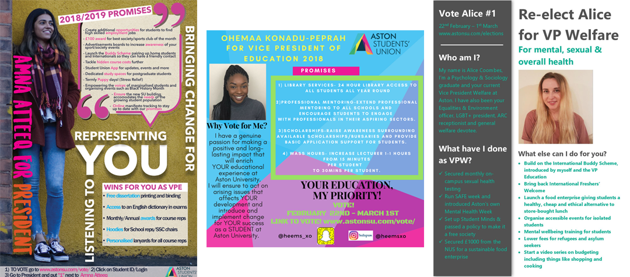
Visual Manifestos
Examples…
Key points
Bold branding and slogan (I got my mate to do this)
Link to voting page!

Slide 24
Visual Manifestos
Examples…
Bold, contrasting type & clear brand
Why vote?

Slide 25
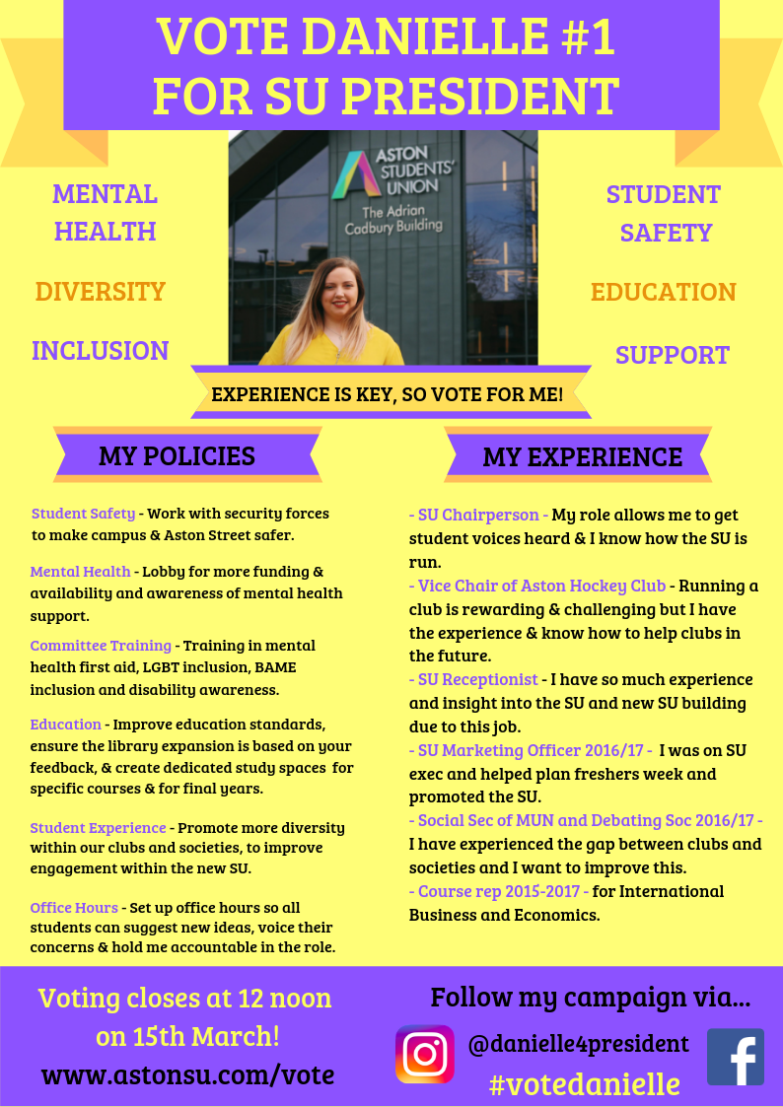
Visual Manifestos

Slide 26


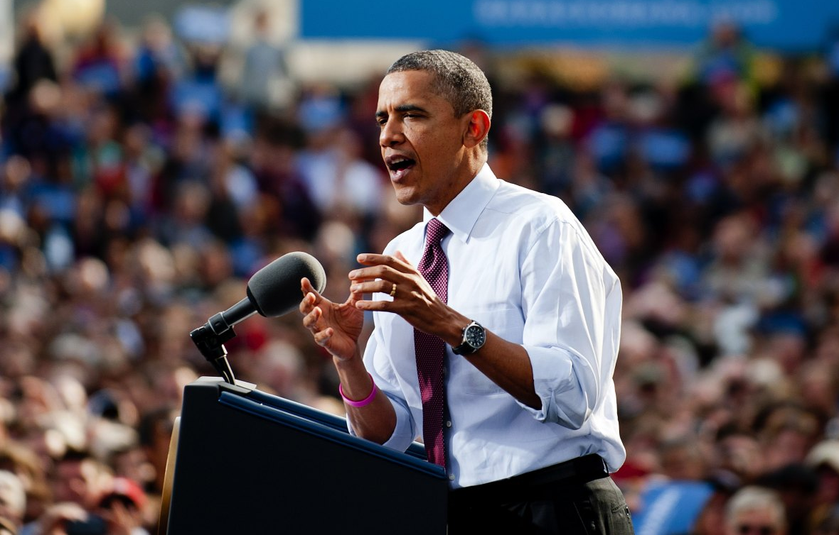

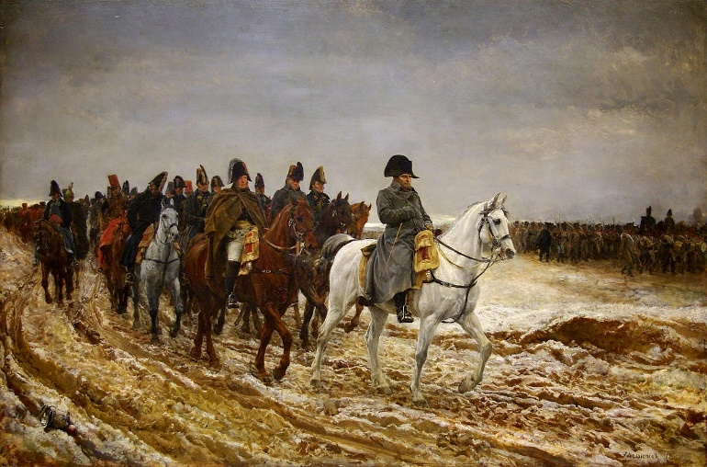
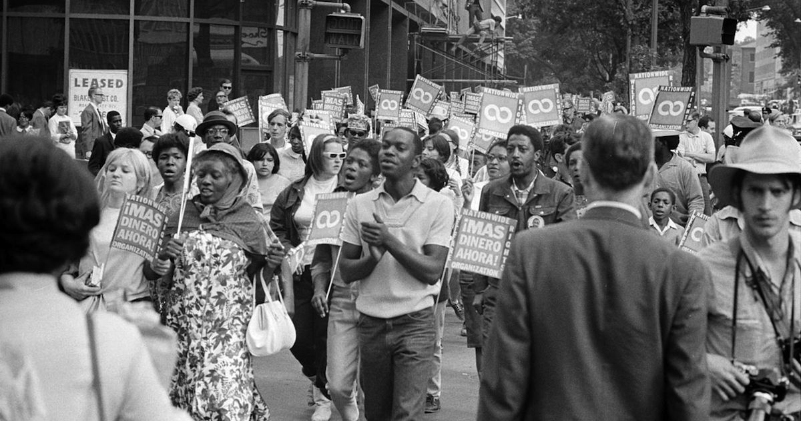
Campaigning 101
What’s a campaign?

Slide 27
Campaigning 101
Campaigning: “working in an organized and active way towards a particular goal, typically a political or social one.”
If you want to win this election, you need people to vote for you! And it’s not enough to just ask your friends to vote; to win you will need to reach lots of different groups of students. To get those votes, you will need to campaign, either online or in person (but probably both). You can do this on your own, or with a team.

Slide 28

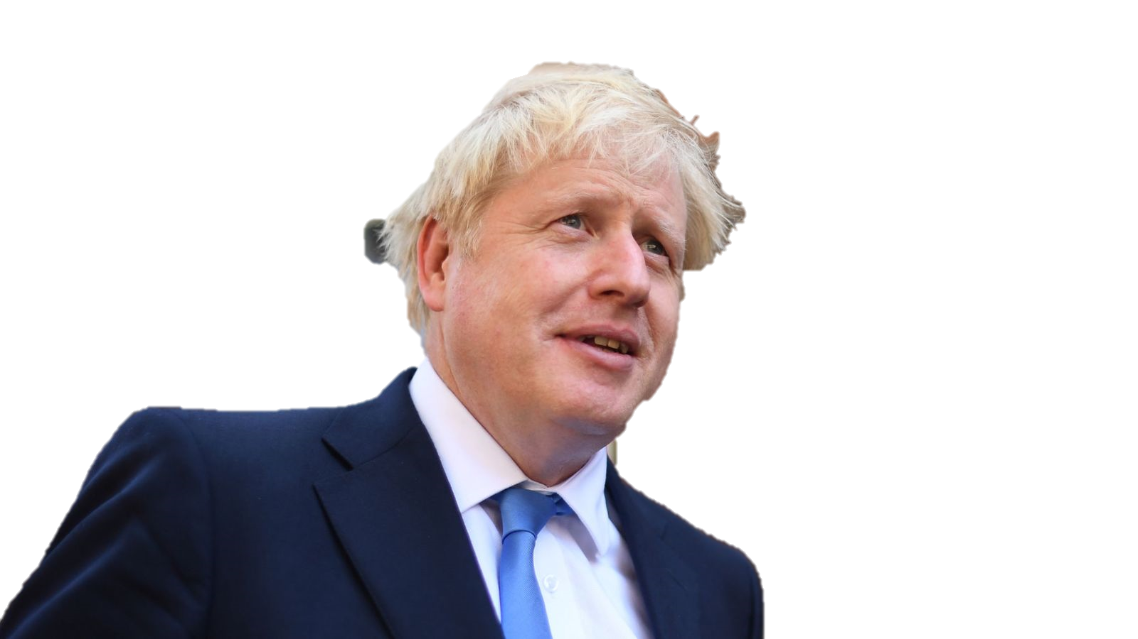
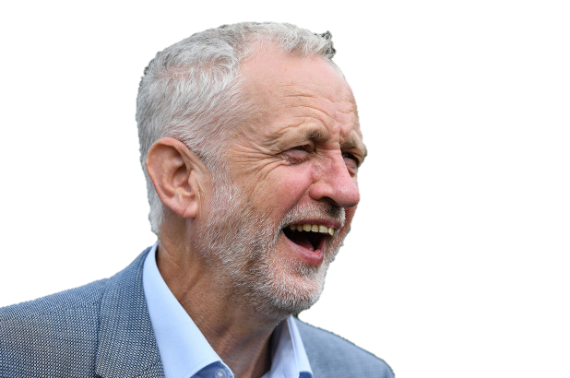
What were the main deciding factors in the 2019 UK Election campaign?

Slide 29
Campaigning 101
Methods for campaigning:
Face-to-Face Campaigning – talking to students in person asking them to vote for you.
Online: Facebook posts (can be paid), making a group and adding people…
Attending events: Club/society events, other on-campus events…
Using creative materials: T-shirts, cardboard, flyers…

Slide 30
Campaigning 101
Offline campaigning tips:
Tip #1: Be seen!
Students will vote for the best candidate they know about. If they don’t know about you, they probably won’t vote for you. Your job is to make sure as many people as possible know about you.
Tip #2: Know your speech
You’ll talk to a lot of people. Make sure you can talk about your policies in a short ‘elevator pitch’ that you can give to someone in a few seconds.
Tip #3: Get creative!
You have a budget to use, as well as some materials from your SU. How can you use it to get the most coverage? How can you make your brand stay in people’s minds?

Slide 31
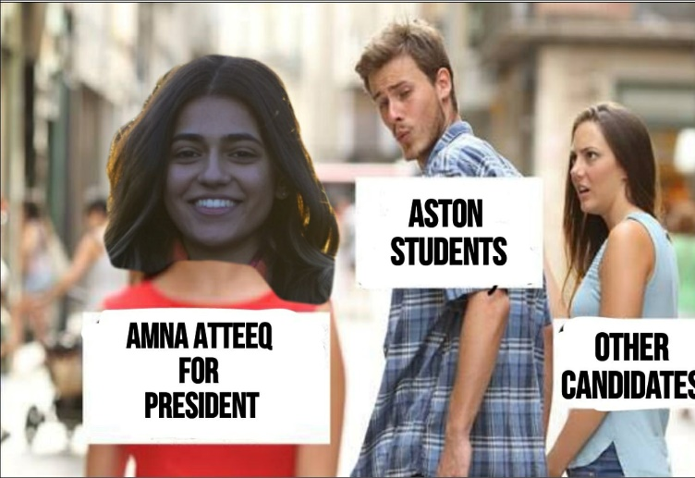
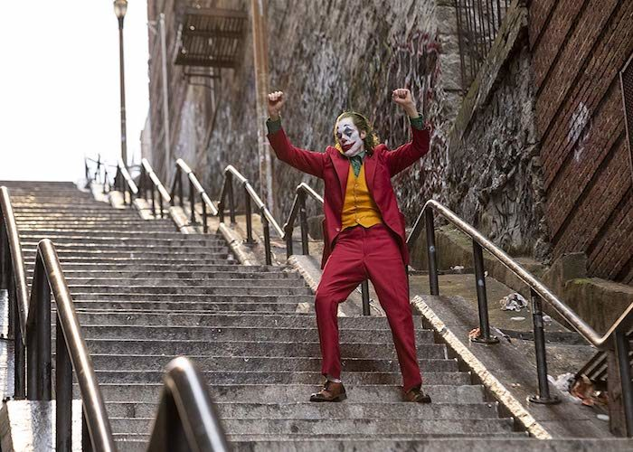
Campaigning 101
Online campaigning:
Viral marketing – can you create something that people will share?
Paid posts – you can sponsor posts on social media (this will come out of your budget)
Think outside the box – how can you expand your reach?

Slide 32

Campaigning 101
ACTIVITY
Practice your elevator pitch! In pairs/small groups, take it in turns to sell your favourite TV programme/film/band.
You have 1 minute to make it as convincing as possible!

Slide 33
Campaigning 101
Demonstration
Practice your elevator pitch! In pairs/small groups, take it in turns to sell your favourite TV programme/film. You have 1 minute to make it as convincing as possible!

Slide 34
Making a Campaign Video
Can you make something that will go viral?

Slide 35

Candidate Wellbeing
Campaigning is fun…
…but it can be tough!
Make sure to take care of yourself while you campaign.

Slide 36


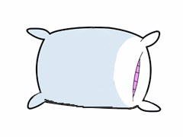
Candidate Wellbeing
Make sure you:
Eat
Drink
Sleep!
Let your friends know that you might need extra support during campaigning.

Slide 37

Candidate Breakfast!
Candidate breakfast and briefing will be held every day in the SU from 8:30 - 10.
Come down for food, drinks and to learn valuable information about voting!

Slide 38

Questions?

